Slide 1


Robotics WOS – Challenge Statement
You’re enjoying your favourite breakfast on a beautiful morning when you heard a broadcast on the radio: “Citizens of Mindcraft, I solemnly report that a cave has collapsed, trapping an unknown number of miners in an uncharted cave!” As the Mayor and respected engineer in your community, you leap out of your chair and vow to save the day!
After cracking your brains, you draft up a plan to design a search and rescue robot with the following features:
A lidar to map the environment of a gridded map
A LDR device to find any light source from miners’ hats
Wireless communication to transfer telemetry from the robot to a remote user
A mechanical mount to robustly hold and elevate the lidar
Luckily, the mining company has a fleet of remotely-operated vehicles that can traverse the tricky terrain in the cave. Your task is to equip and use the vehicle to
Produce a map of the cave to facilitate sending in a medical evacuation team
Mark on the gridded map where light from miners’ hats are located to focus rescue efforts
Avoid crashing into obstacles at all cost
Do it as quickly as possible – time is of the essence!

Slide 2
Misc
Do yourself a favor, and download “Terminator” in your ubuntu software
Ctrl + Shift + O : Splits terminal horizontally
Ctrl + Shift + E : Splits terminal vertically
Ctrl + Shift + W: Close terminal

Slide 3
Configuring ROS setup for Ubuntu
In command line on Ubuntu, run $ cd ~ && git clone https://github.com/sonowhale/catkinWOS_ws.git
You should get a folder named “catkinWOS_ws” in your home directory
Change directory into the workspace by running
$ cd catkinWOS_ws
To build the catkin workspace, run
$ catkin_make
For the terminal to “see” the new ROS packages that you’ve built, you need to source the devel setup.bash file everytime you open the terminal. Recall that you may do so by editing the bashrc file. Run
$ echo “source ~/catkinWOS_ws/devel/setup.bash” >> ~/.bashrc
Now, close all terminals
Open a new terminal and run:
$ sudo chmod 777 /dev/ttyUSB0
You’ll be prompted for your device password
On the same terminal, run:
$ roslaunch rplidar_ros view_rplidar.launch
Note: When you do the wireless setup later, you might not be required to use the roslaunch command

Slide 4
Setting up Wireless Communications
First, find out your RaspberryPi IP address by approaching your friendly instructors
Configure multi-machine ROS (with raspberry pi as main). You should strive to obtain a WIRELESS setup, with the lidar linked to the raspberry pi, and the RViz display on your screen. This reference may be useful: https://wiki.ros.org/ROS/Tutorials/MultipleMachines
Hints: a) To perform ‘ssh’ into raspberry pi, both machines should be connected to a common WiFi. b) Make sure that your 2 machines are communicating by ping-ing and/or passing a simple talker/listener ROS message.

Slide 5
Configuring ROS Setup for RaspberryPi
Access your raspberryPi by running ssh
In command line on RaspberryPi, run
$ cd ~ && git clone https://github.com/sonowhale/catkinPI_ws.git
You should get a folder named “catkinPI_ws” in your RaspberryPi home directory
Change directory into the workspace by running
$ cd catkinPI_ws
To build the catkin workspace, run
$ catkin_make
For the terminal to “see” the new ROS packages that you’ve built, you need to source the devel setup.bash file everytime you open the terminal. Recall that you may do so by editing the bashrc file. Run
$ echo “source ~/catkinPI_ws/devel/setup.bash” >> ~/.bashrc
Now, close all terminals
Note: Before proceeding, you’re expected to fill in your own code in gpio_ros/src/readGPIO.cpp To do so, 1) run $ roscd gpio_ros, 2) run $ nano src/readGPIO.cpp
Note: After which, you should apply your knowledge in ROS topics to communicate between terminals.

Slide 6
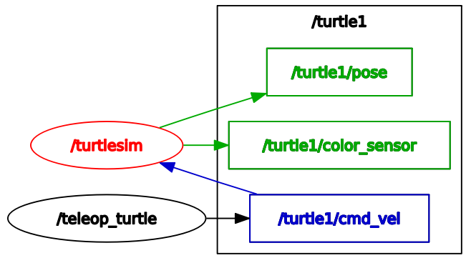
Recap – ROS Packages, Nodes, and Topics
Packages
Packages are like a ‘container’ for a group of nodes. For instance, turtlebot_sim can pack /turtlesim and /teleop_turtle nodes as these nodes are highly related
Nodes
Nodes are akin to various executable files that are created to fulfil a certain role. You can have multiple nodes in any single package.
Topics
Topics are akin to a “conversation space”. Nodes can publish or subscribe into a topic to pass information to one another. Each node can publish/subscribe to multiple topics

Slide 7
Recap – ROS Packages, Nodes, and Topics
How to identify these in your file system?
catkinPi_ws
> src
>> Package A [e.g. rplidar_ros]
>>> src
>>> CMakeLists.txt
>>> package.xml
>>> Other files
>> Package B [e.g. gpio_ros]
>>> src
>>> CMakeLists.txt
>>> package.xml
>> CMakeLists.txt
> build [These are generated by catkin_make!]
> devel [These are generated by catkin_make!]
You put your C/C++ source code in here!
Series of instructions for catkin_make to build this package!
(i.e. convert from source code to binaries)
You put your C/C++ source code in here!
Series of instructions for catkin_make to build this package!
(i.e. convert from source code to binaries)
Outerloop series of instructions for catkin_make to perform compilation!
Recall: catkin_make is a command to BUILD your source code for ROS applications.
It is similar to basic cmake –build for typical C++ applications

Slide 8
Why change the ~/.bashrc?
We have been adding alot of commands into ~/.bashrc, such as echo “source ~/catkin_ws/devel/setup.bash” >> ~/.bashrc
Why?
When we create a new packages in a new workspace (e.g. catkinNEW_ws), your shell environment (i.e. terminal) needs to know that these packages exists and WHERE to find them. This can be done by running the ~/catkinNEW_ws/devel/setup.bash script.
Opening the terminal always executes ~/.bashrc file. Therefore, by changing the ~/.bashrc script means that EVERY terminal you open from now on will run the bash script and be aware of WHERE to find the packages
source tells the shell environment to RUN the following .bash script
echo means to add the following string into the ~/.bashrc file

Slide 9
Recap – ROS Packages, Nodes, and Topics
Listener.cpp (example)
#include "ros/ros.h"
#include "std_msgs/String.h"
void chatterCallback(const std_msgs::String::ConstPtr& msg)
{
ROS_INFO("I heard: [%s]", msg->data.c_str());
}
int main(int argc, char **argv)
{
ros::init(argc, argv, "listener");
ros::NodeHandle n;
ros::Subscriber sub =
n.subscribe("chatter", 1000, chatterCallback);
ros::spin();
return 0;
}
How to identify these in your file system?
catkinPi_ws
> src
>> Package A [e.g. rplidar_ros]
>>> src
>>> CMakeLists.txt
>>> package.xml
>>> Other files
>> Package B [e.g. gpio_ros]
>>> src
>>> CMakeLists.txt
>>> package.xml
>> CMakeLists.txt
> build [These are generated by catkin_make!]
> devel [These are generated by catkin_make!]
You put your C/C++ source code in here!
Series of instructions for catkin_make to build this package!
(i.e. convert from source code to binaries)

Slide 10


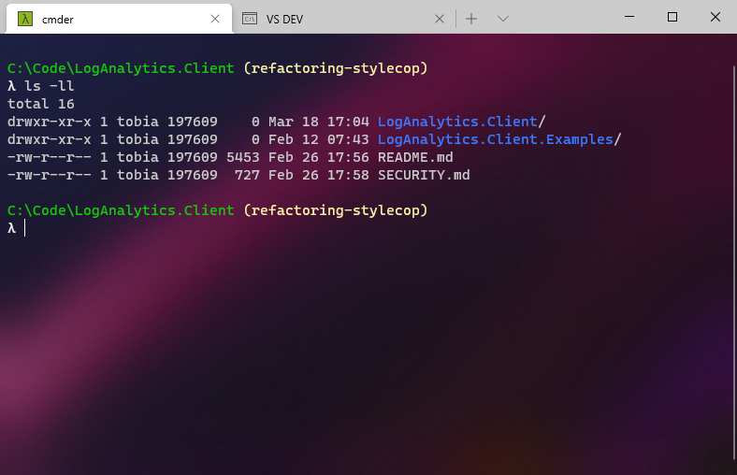
Why change the ~/.bashrc?
We have been adding alot of commands into ~/.bashrc, such as echo “source ~/catkin_ws/devel/setup.bash” >> ~/.bashrc
source tells the shell environment to RUN the following .bash script
echo means to add the following string into the ~/.bashrc file
+
bashrc
made known by running source ~/X/devel/setup.bash
opt/ros/noetic/share
automatically called
ROS_PACKAGE_PATH
catkin_ws/src
New terminal

Slide 11

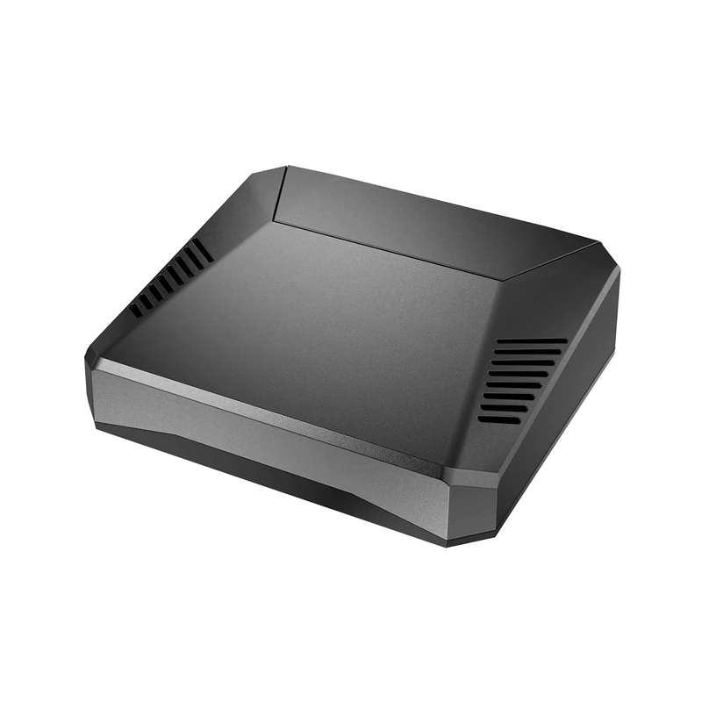


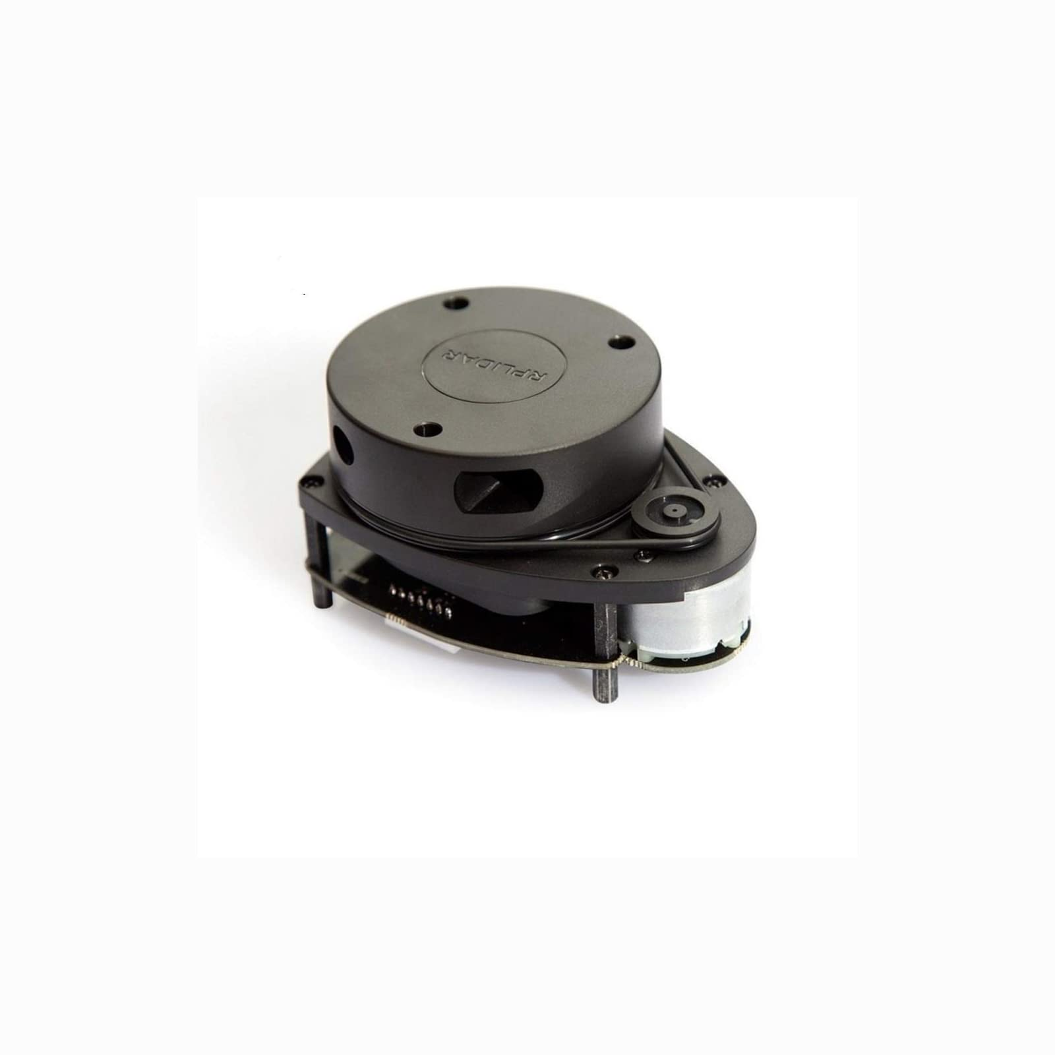
What did we do yesterday?
SSH to remotely access the RaspberryPi and make changes via command line and nano
We publish and subscribe ROS topics on different platforms over Wi-Fi
ssh
ROS_MASTER_URI = PI
ROS_MASTER_URI = PI
Some node from desktop
Topic 1 [/LDR_outputs]
RViz on desktop
Topic 2 [/scan]

Slide 12
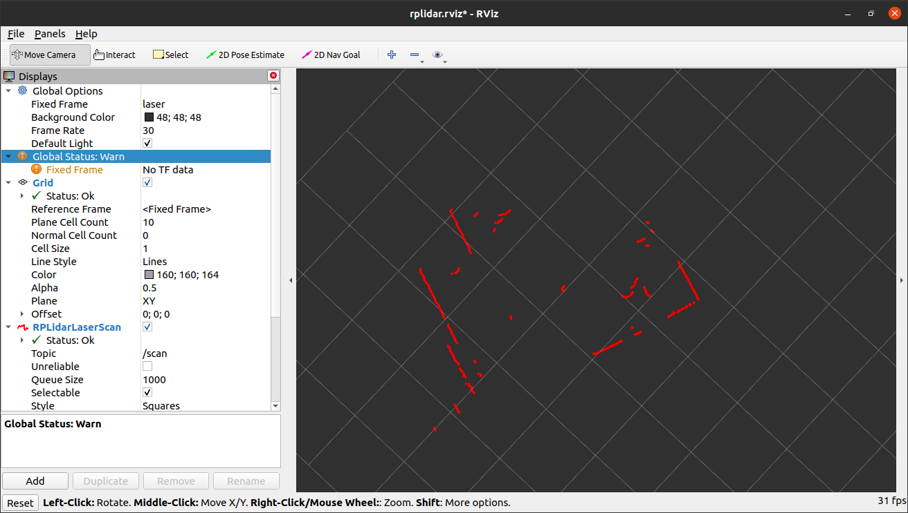
Brief Introduction to Rviz
Useful ROS package to display common sensor messages
Add new data to display

Slide 13
So what have we done yesterday?
We remotely accessed your RaspberryPi with your desktop via ssh. This allows us to make changes into RaspberryPi without the need for a monitor display (if you are good with command line)!
To write code in RaspberryPi remotely, we need to use the nano command line interface editor.
We made 2 systems running ROS communicate with each other via ROS topics!

